Slide 1
MIE & SIP Status
Bijan Chamanbahar

Slide 2
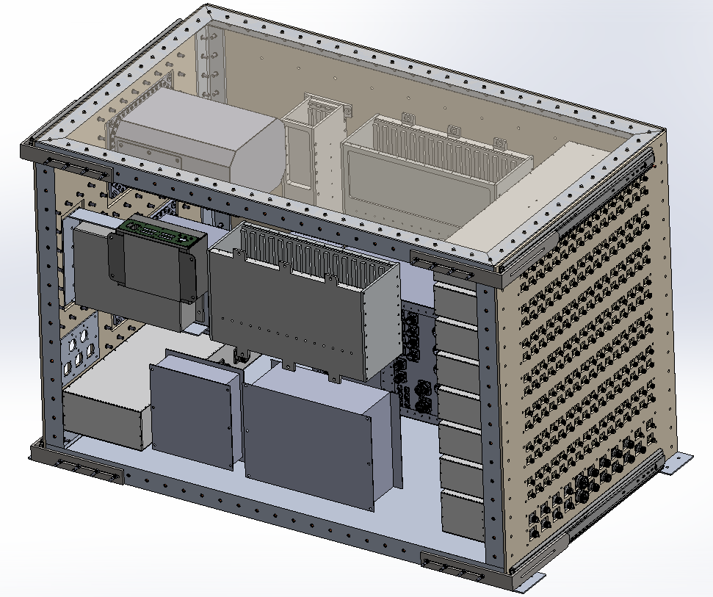
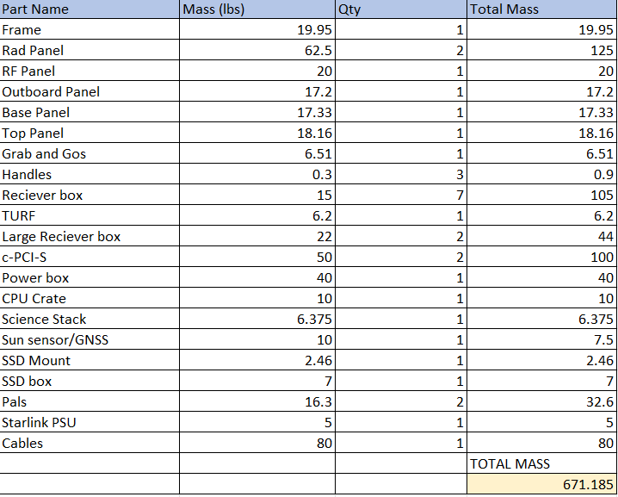
Current MIE Configuration
Placements and features have been finalized
Total weight is now 671 lbs

Slide 3
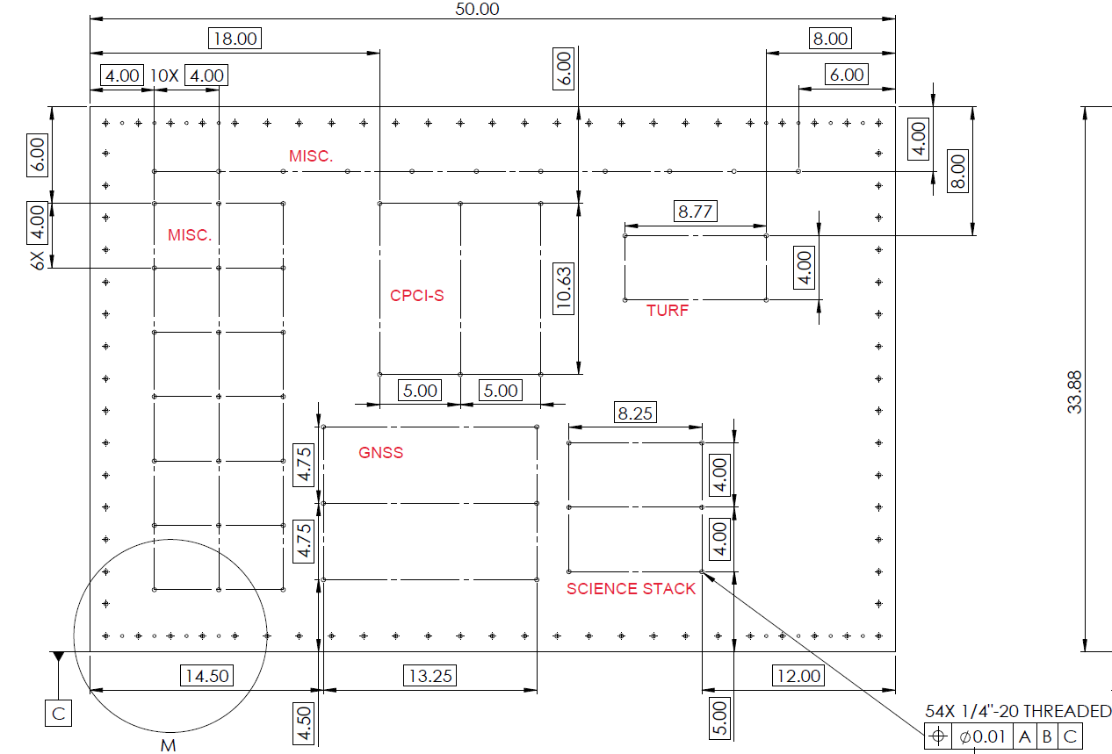
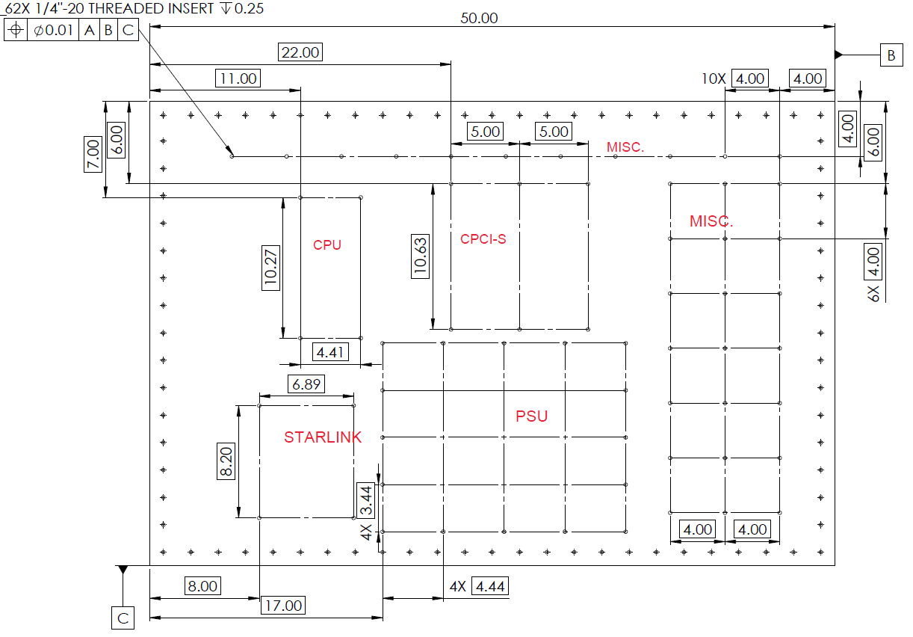
Current MIE Configuration

Slide 4
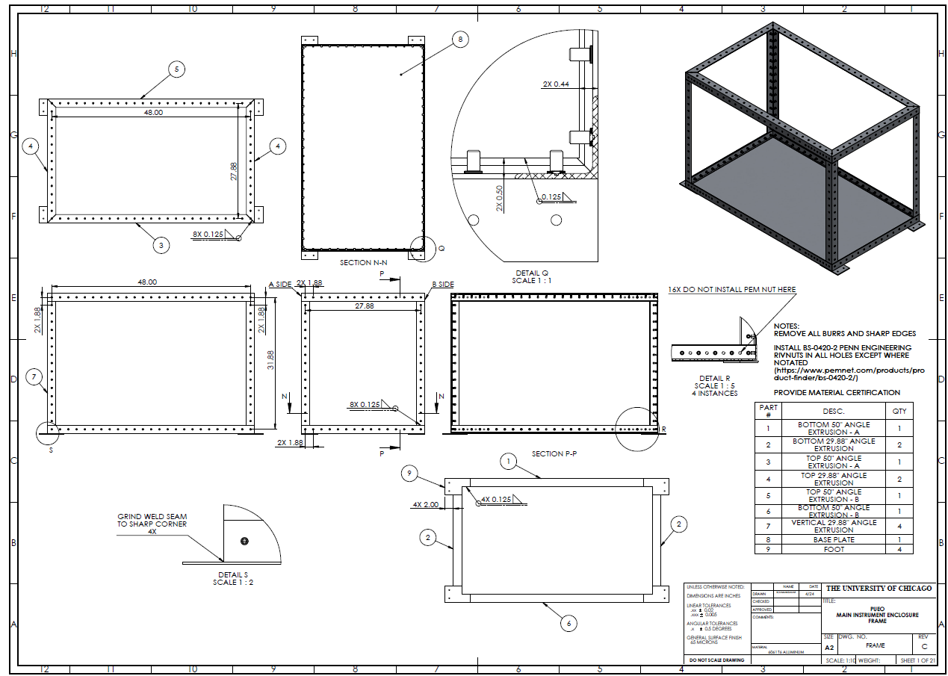
MIE Fabrication Status
Currently in active correspondence with two shops for a quote
Waiting to hear back from reliable plating for electroless nickel plating quote
Changed material from magnesium to aluminum for a quicker lead time
Once a quote has been received more accurate schedule adjustments can be made

Slide 5
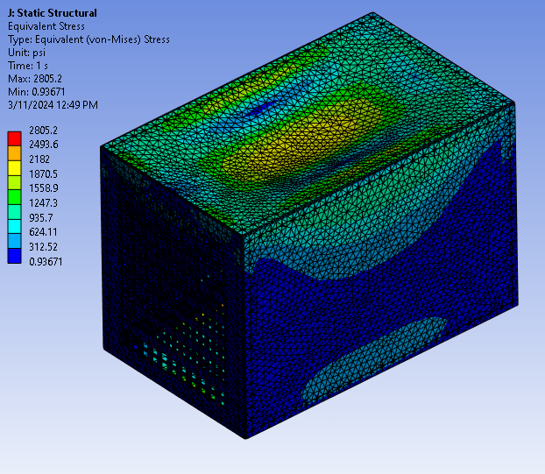
MIE Next steps
Continue communication with shops to expedite manufacturing
Re-run analysis with updated materials
Draft cable routing for assembly assistance and cable lengths
Testing and assembly
Ship to palestine

Slide 6
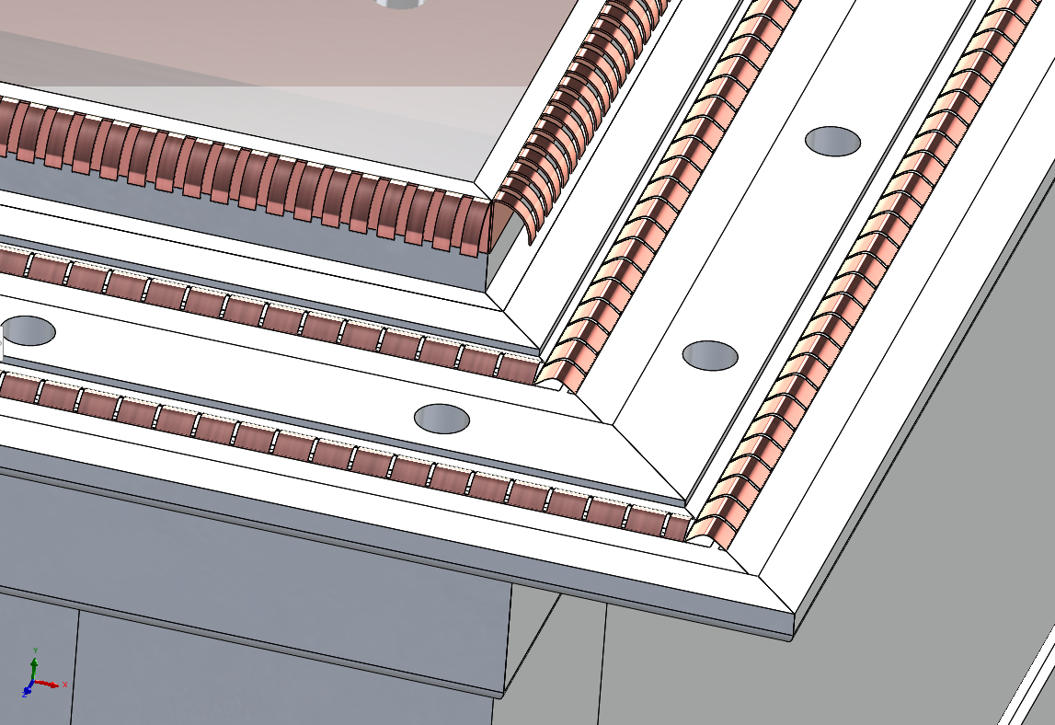
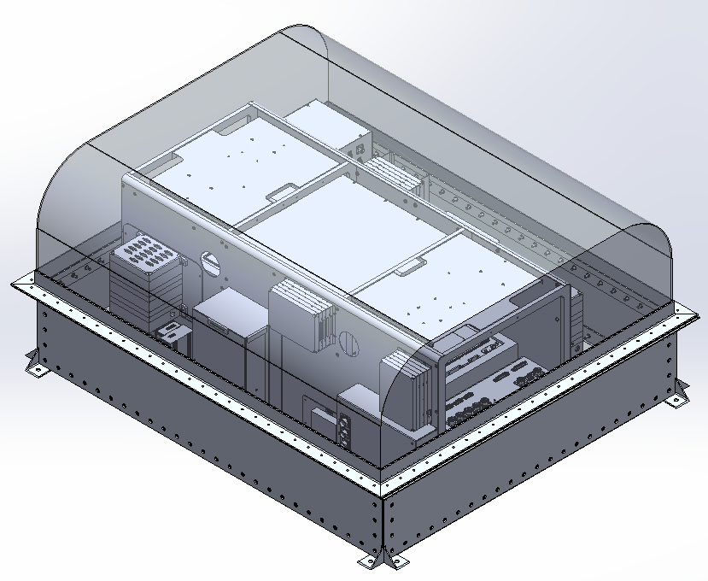
Current SIP Configuration
All dimensions are kept similar to original SIP
Utilizes flange + fingerstock for RF sealing
Current weight: 119lbs (Frame only)

Slide 7
SIP Next Steps
Add receiver boxes and cutouts to assembly
Finalize weights
Run analysis and validation (CSBF involvement?)
Draft drawings and start manufacture

